Slide 1


AI at Work
Chrissy LeMaire, MVP
Notes:
ABSTRACT:
In the same way that PowerShell has helped streamline processes and make work more enjoyable, generative AI chatbots like ChatGPT can do the same for a variety of mundane things that come with having a job. Whether it's writing Disaster Recovery documentation or self-evaluations, creating cover letters for resumes, getting Kerberos troubleshooting steps for your specific environment or looking through large logs to pinpoint the deeply-hidden issue, generative AI can do pretty much anything except write this abstract, apparently. Join me for a hands-on session where I'll compare services like ChatGPT, Bard, M365 Chat/Copilot and GitHub Copilot Chat. I'll also show you how to get the best results (hint: it's not Prompt Engineering) and demo some of my favorite things I've used ChatGPT for ever since I upgraded to v4. I'll also address some of the privacy concerns and how to mitigate them.

Slide 2


Microsoft MVP
GitHub Star
AI at Work
Notes:
I am a Dual Microsoft MVP and GitHub Star. I’m also the recipient of GitHub’s Top Teacher award.

Slide 3

Software Engineer
Back to good ol’ SharePoint
Notes:
And I’m a software engineer at Leidos.
Leidos makes:
advanced technology solutions for defense and security
healthcare technology and services
data analytics tools
enterprise IT solutions
artificial intelligence and machine learning applications
engineering and scientific research services
space and aeronautics systems
cloud computing solutions

Slide 4

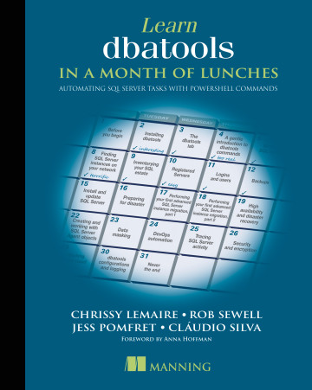
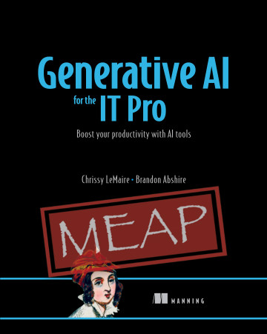
anning author
45% off
lemaire3pseu
AI at Work
Notes:
I’m also an author and these are my two books.

Slide 5

Exclusively on LinkedIn
gptmaker.dev/linkedin

Slide 6

Any sufficiently advanced technology
is indistinguishable from magic.
~Arthur C. Clarke
Notes:
This is AI to me. I mean, look at this…

Slide 7
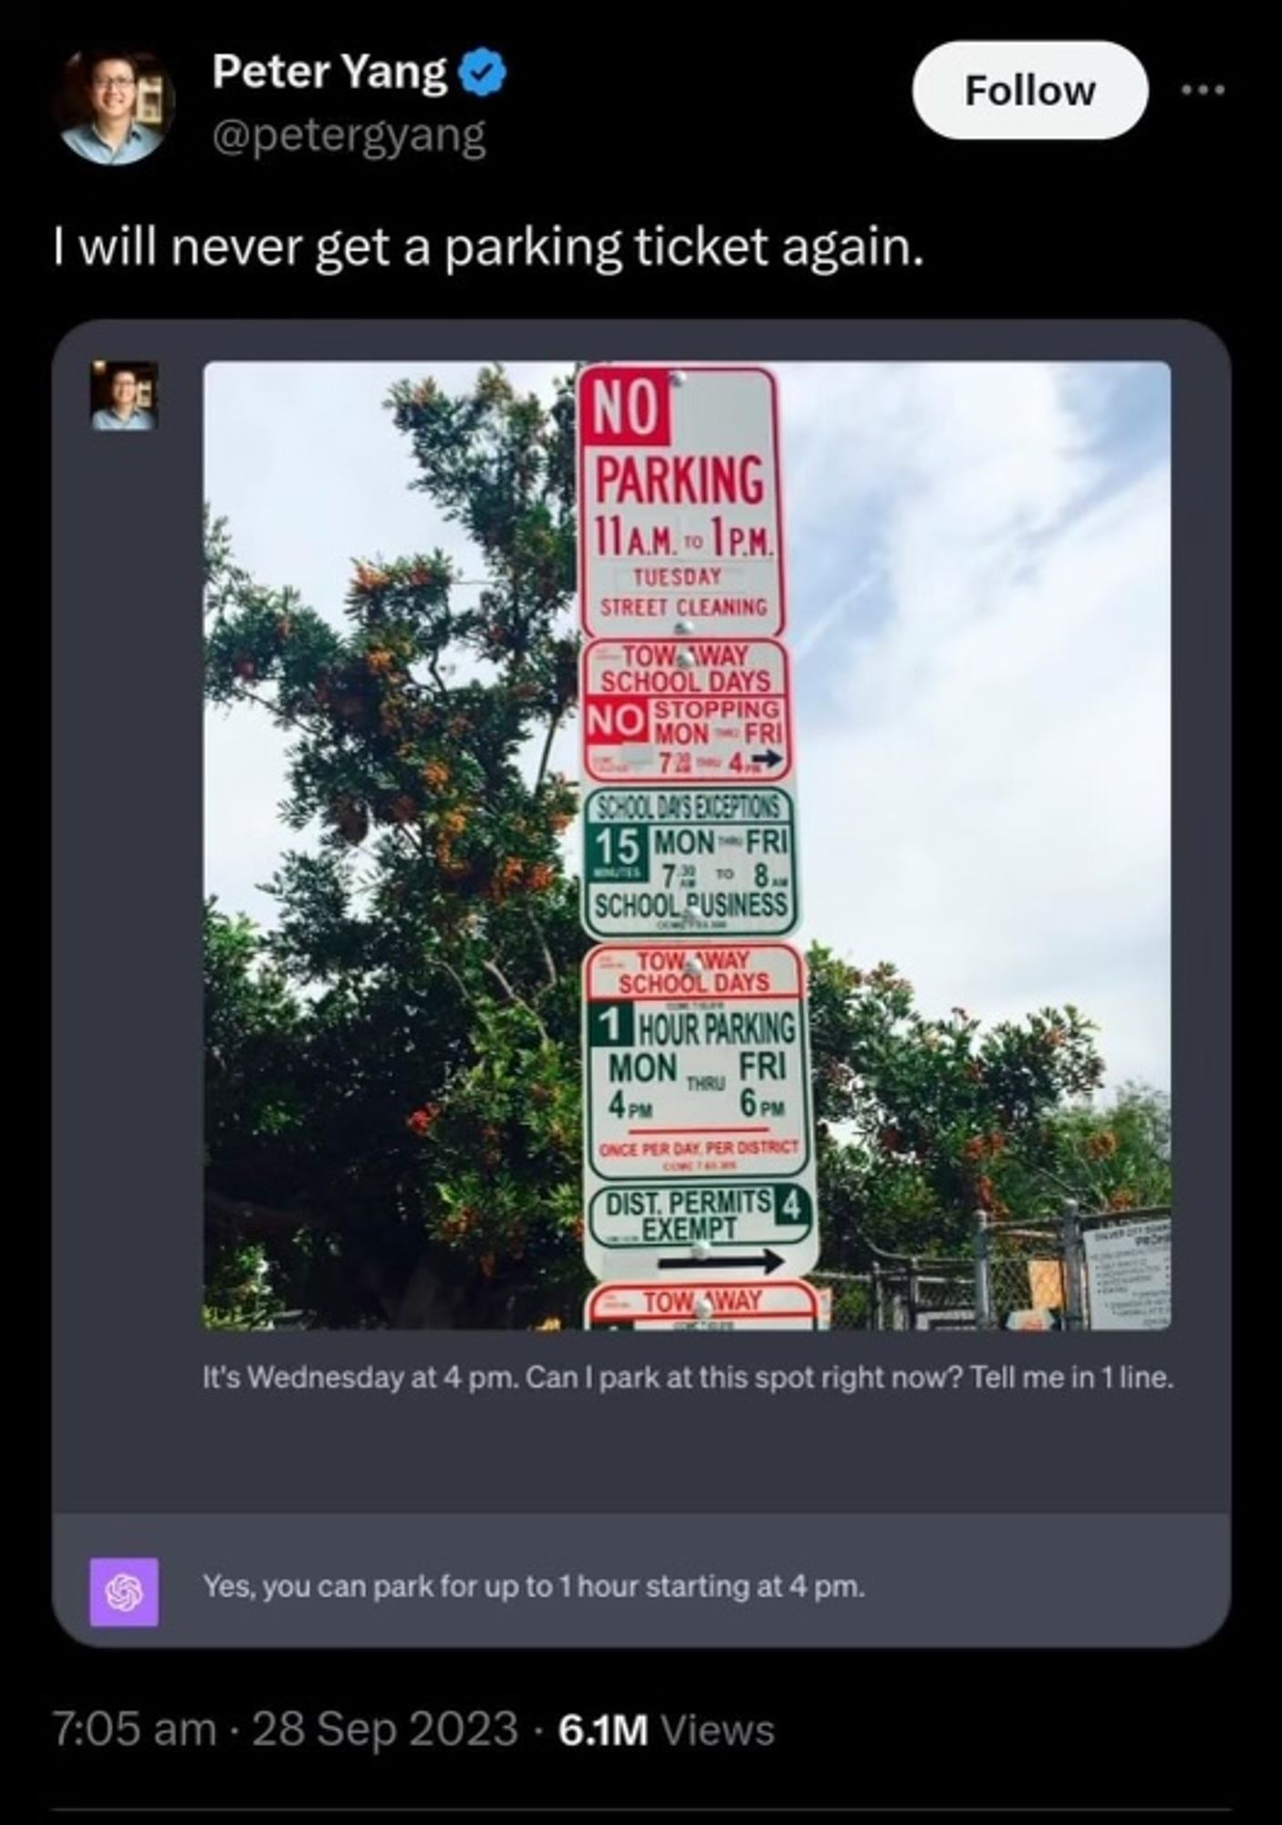
Notes:
This was some of the first magic that opened my eyes to original uses of ChatGPT

Slide 8
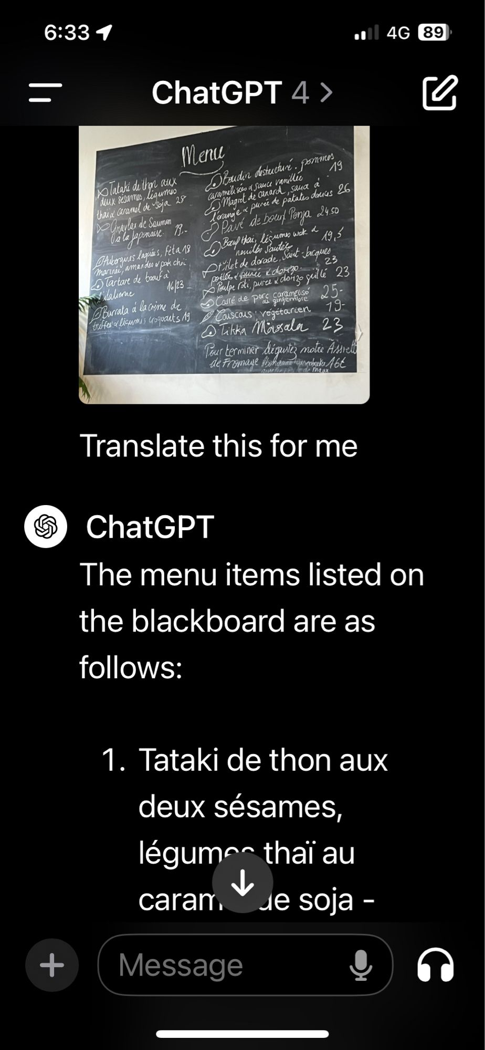
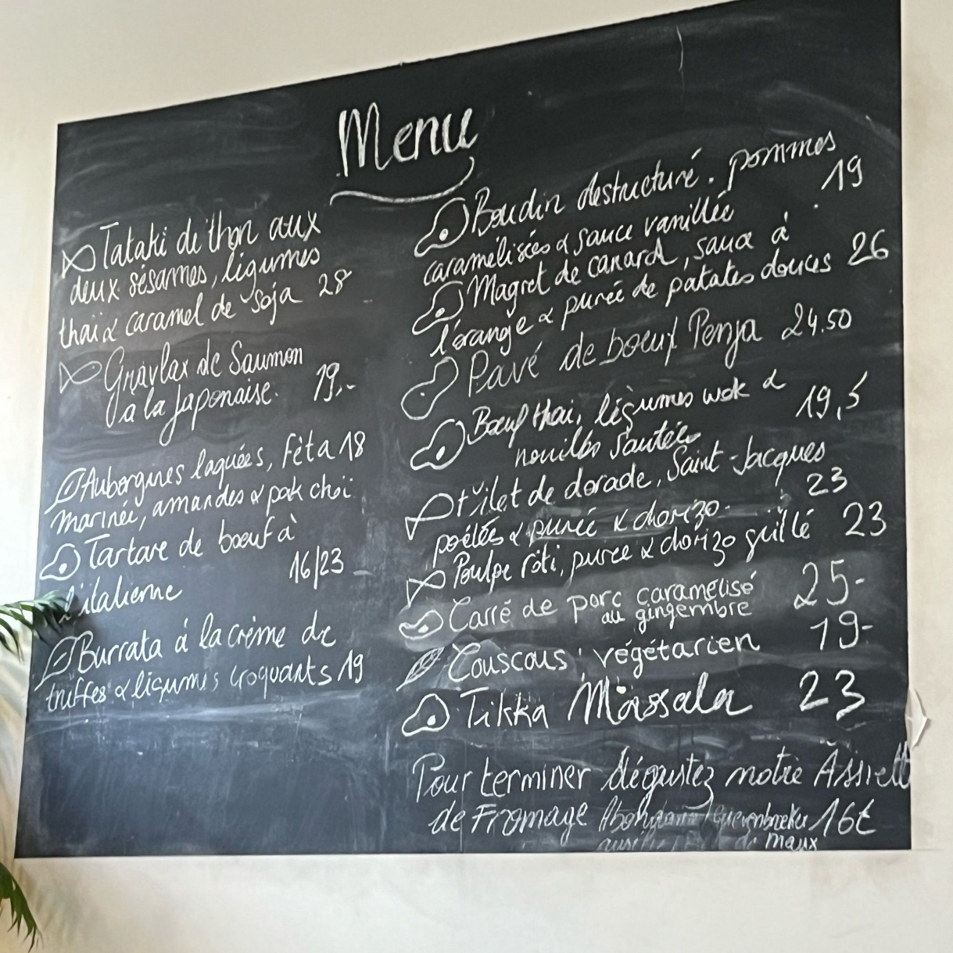
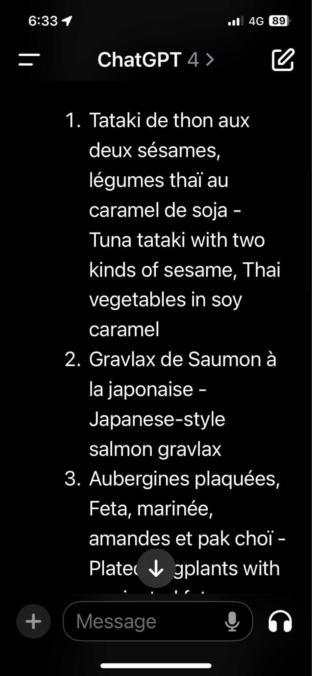
Notes:
I’ve also created my own magic – there was this restaurant we were avoiding going to for months because they didn’t have real menus. Just a menu on the wall. After finally deciding to go, I used ChatGPT to address three issues:
A far away chalkboard
Written in cursive
In a foreign language

Slide 9

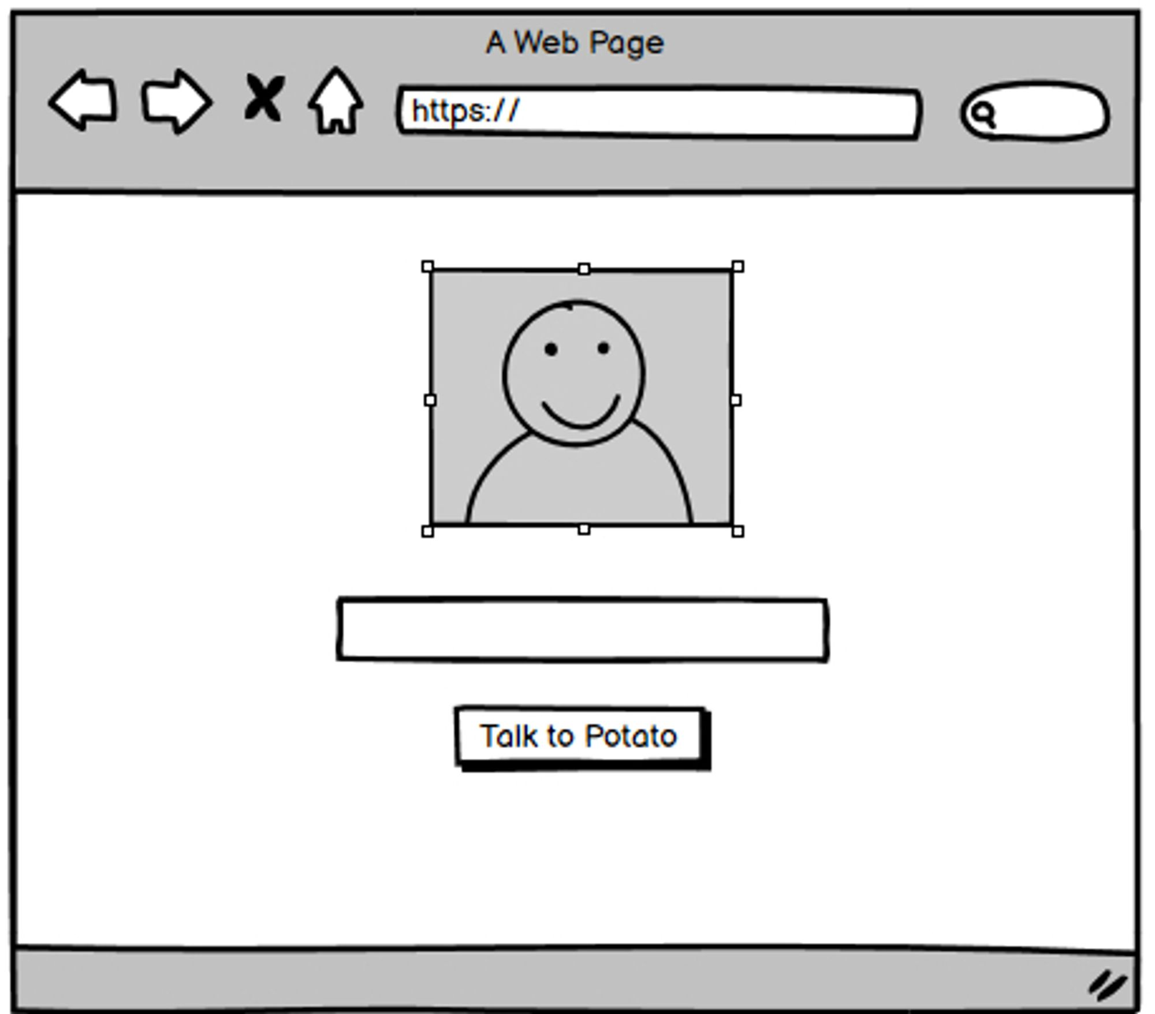
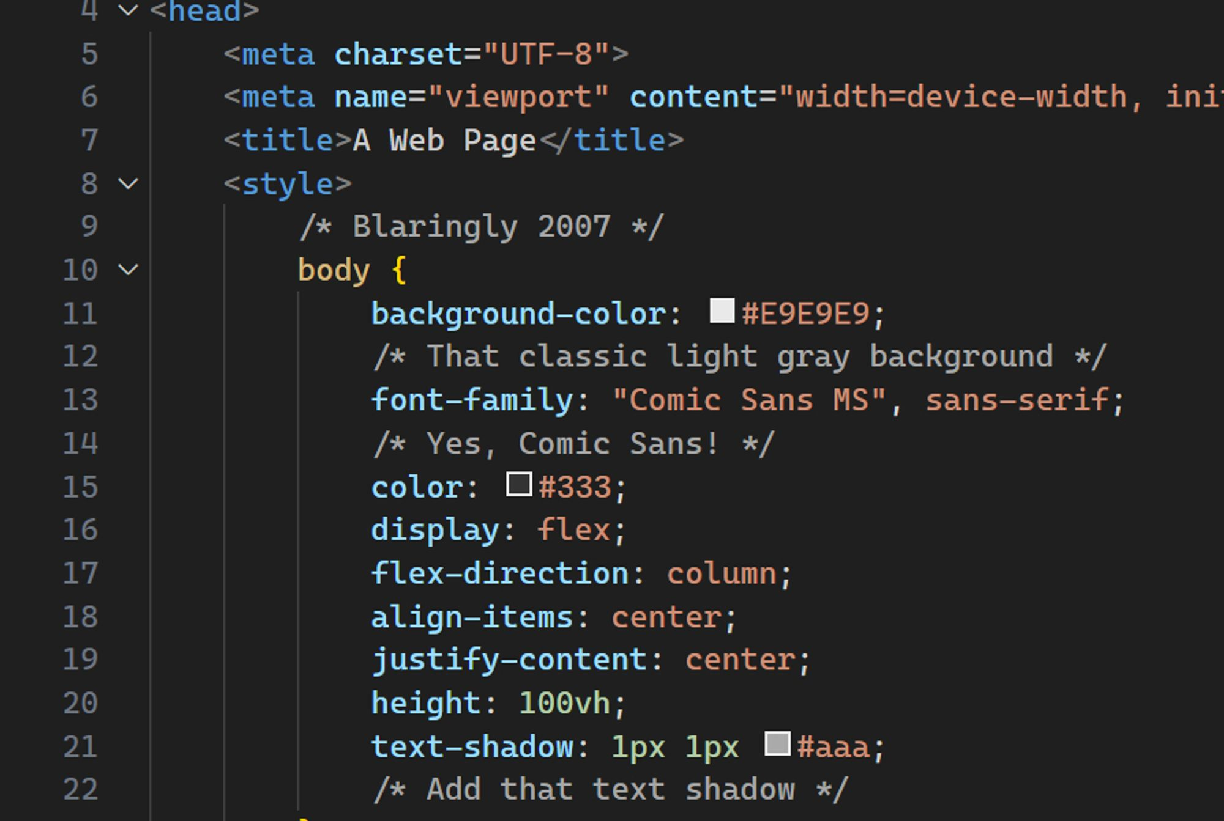
Notes:
As for as one of the first things I used it for that was work related…. Remember the hype going around was that you could draw your website on a napkin and it would convert it into code.
I tried this with Balsamiq mockups for my own Tot Bot (chatbot that has the personality of my cat Potato) fine-tuning project and it worked! It even gave me a slick 2007-style UI.

Slide 10
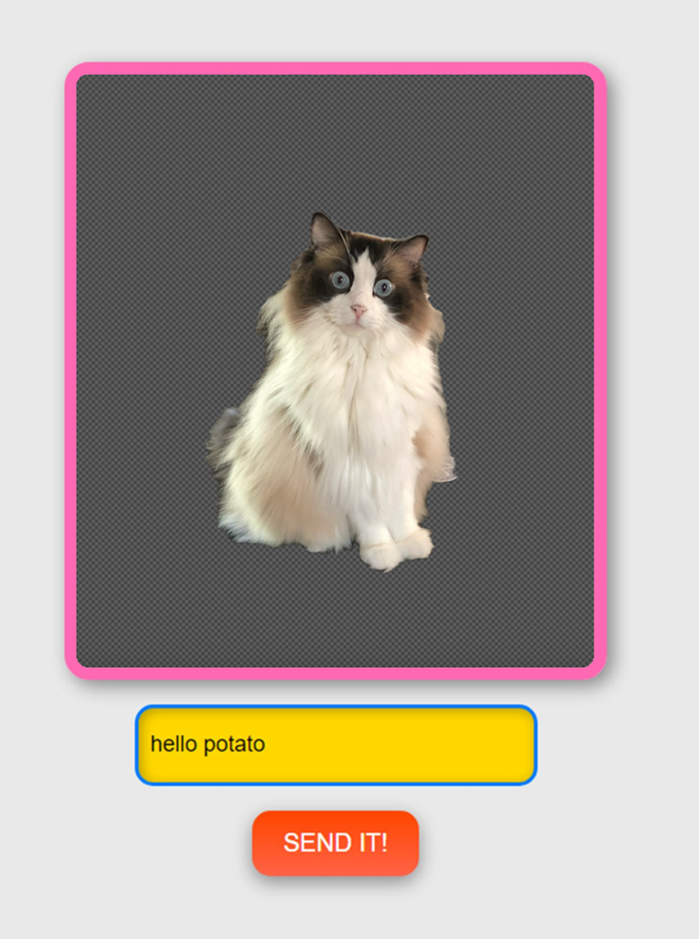
Notes:
Tada! It’s a tot bot.

Slide 11
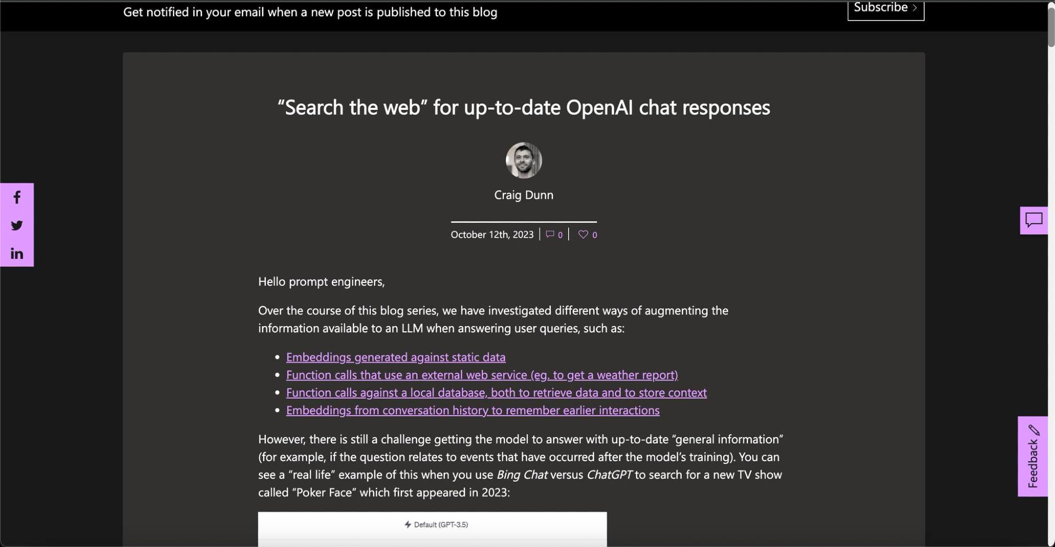
Notes:
I also used it to do one of my favorite things – create THEMES! In this case, I fell in love with the theme of this Microsoft blog.

Slide 12
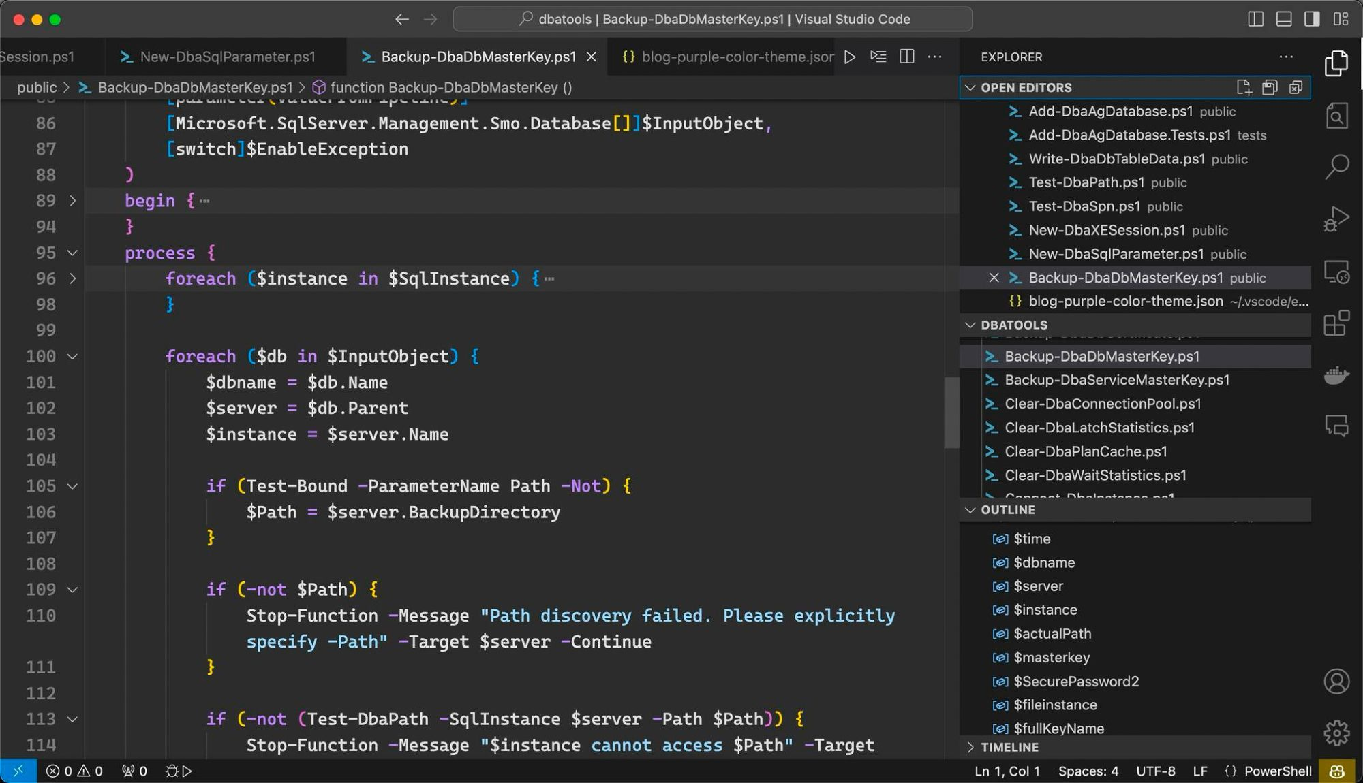
Notes:
And turned it into a Visual Studio code theme. Asking it to fill in the blanks with complementary colors.

Slide 13
Agenda
Housekeeping
Current Lineup - Battle of the bots
Tech Solutions
People Solutions
AI at Work

Slide 14
Check your company’s AI policy
AI at Work
Notes:
Before using AI at Work, always be sure to check your company policy. Some companies are explicitly disallowing it, though most (like the company I work for) seem to be embracing it and even providing training. So check for training!

Slide 15
Privacy & Security
privacy.openai.com
Redact when possible
Enterprise Subscriptions
***Use Azure if you can***
AI at Work
Notes:
I always recommend people opt-into greater privacy if privacy is important to them.
Also, even if you do and you’re using OpenAI/ChatGPT, ensure you redact or replace any sensitive information.
OpenAI does offer Enterprise subscriptions that are more privacy focused, but if you want real privacy, use Azure.

Slide 16
Current lineup
Anthropic Claude
- Incredible memory
- Opus is fantastic at coding advanced or long commands
- Even better at writing and I use it often for our book
OpenAI ChatGPT
- Powerful free tier and best all-around bot
- Excels at vision
- Custom GPTs are awesome
AI at Work
Notes:
Let’s talk about some of the bots available.

Slide 17
Current lineup
Microsoft Copilot for M365
- Part of the Microsoft Ecosystem, so offers deep integration
- Observable difference in responses and capabilities compared to ChatGPT4
Google Gemini
- Part of the Google Ecosystem, so offers deep integration
- Very inaccurate in the testing I did. The worst of all the bots. Others had luck.
AI at Work
Notes:
Part of the Microsoft Ecosystem which is great but it’s also a limitation as it’s only available to M365 users.

Slide 18
Current lineup
OpenAI API
- Newest models
- Far more control
- Often performs better than ChatGPT
Azure AI Services
- Privacy-focused
- Often lags a little with new models
- Have to pay for storage too
AI at Work

Slide 19
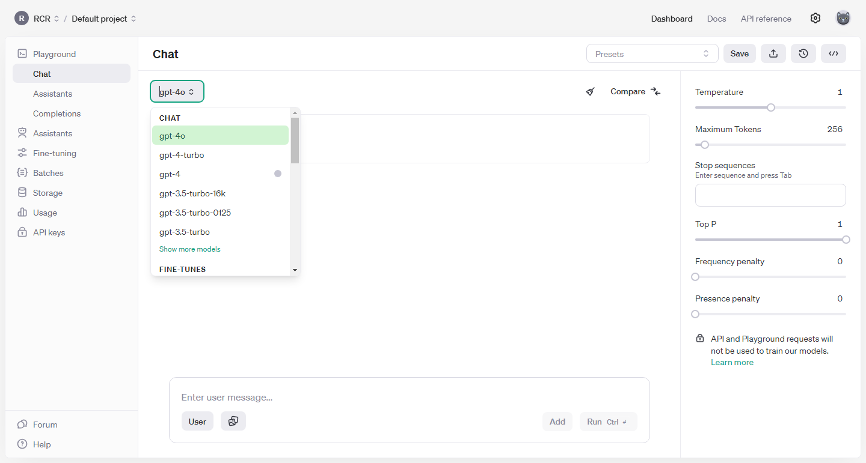
AI at Work

Slide 20
Cost
Anthropic Claude Opus
- $20/mo | Dynamic limits but about 20 long messages every 4 hours
OpenAI ChatGPT Plus
- $20/mo | 80 messages every 3 hours on 4o, 40 on 4
Claude Opus – 200,000 token context
Input: $15 / million tokens | Output: $75 / million tokens
OpenAI API 4o – 128,000 token context
Input: $5 / million tokens | Output: $15 / million tokens
Azure AI OpenAI Services API 4o – 128,000 token context
Same as OpenAI API but you also pay for storage
AI at Work

Slide 21
Cost
Anthropic Claude Opus
- Now available in the EU!
- $20/€20/mo
- Gotta wait HOURS if tokens run out
- Dynamic limits but about 20 long messages every 4 hours
OpenAI ChatGPT Plus
- Different subscription from API
- $20/mo
- 80 messages every 3 hours on 4o, 40 on 4.
AI at Work

Slide 22
API Cost
Claude Opus – 200,000 token context
Input: $15 / million tokens
Output: $75 / million tokens
OpenAI API 4o – 128,000 token context
Input: $5 / million tokens
Output: $15 / million tokens
AI at Work
Notes:
About ¾ of word per token

Slide 23
API Cost
Azure AI OpenAI Services API 4o – 128,000 token context
Input: $5 / million tokens
Output: $15 / million tokens * Storage too
AI at Work
Notes:
Build out your product

Slide 24
Open Source & Local LLMs
Haven’t explored much yet due to limited resources
AI at Work
Notes:
Both time and hardware

Slide 25
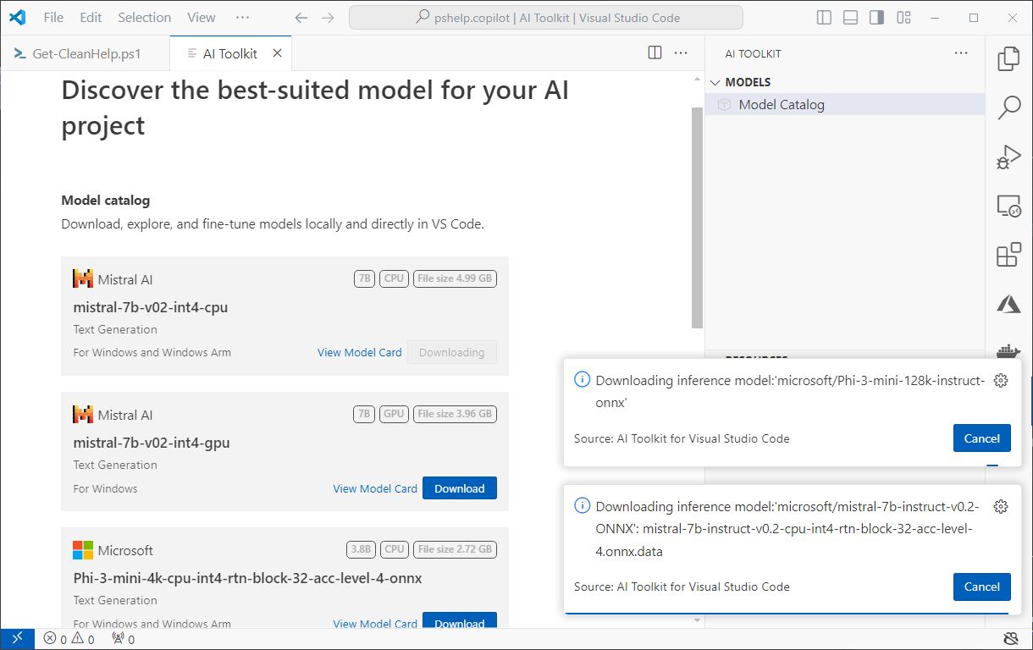
Open Source & Local LLMs
AI at Work

Slide 26
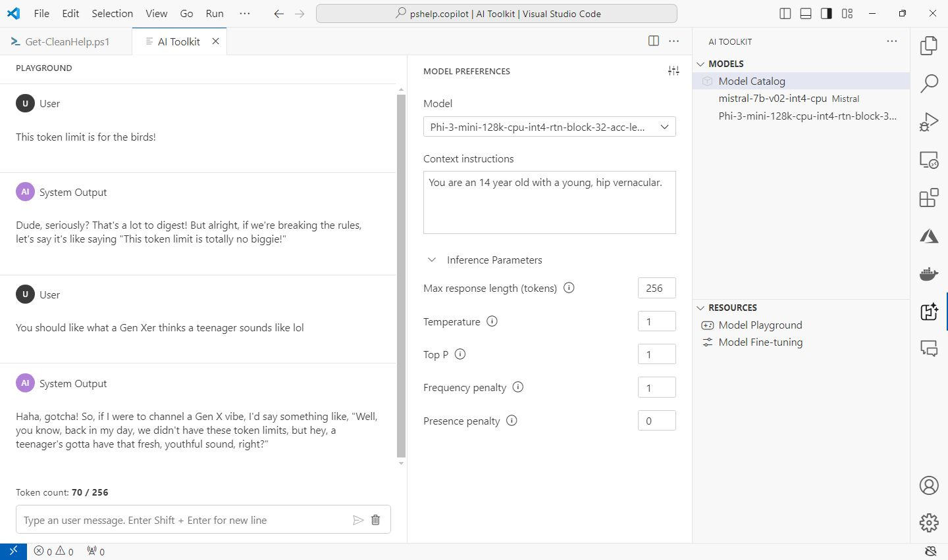
Open Source & Local LLMs
AI at Work

Slide 27
Battle of the Bots
chat.lmsys.org
AI at Work

Slide 28

The Tech Part
AI at Work

Slide 29
"[AI] is every bit as important as the PC, as the internet.“
~ Bill Gates
AI at Work

Slide 30
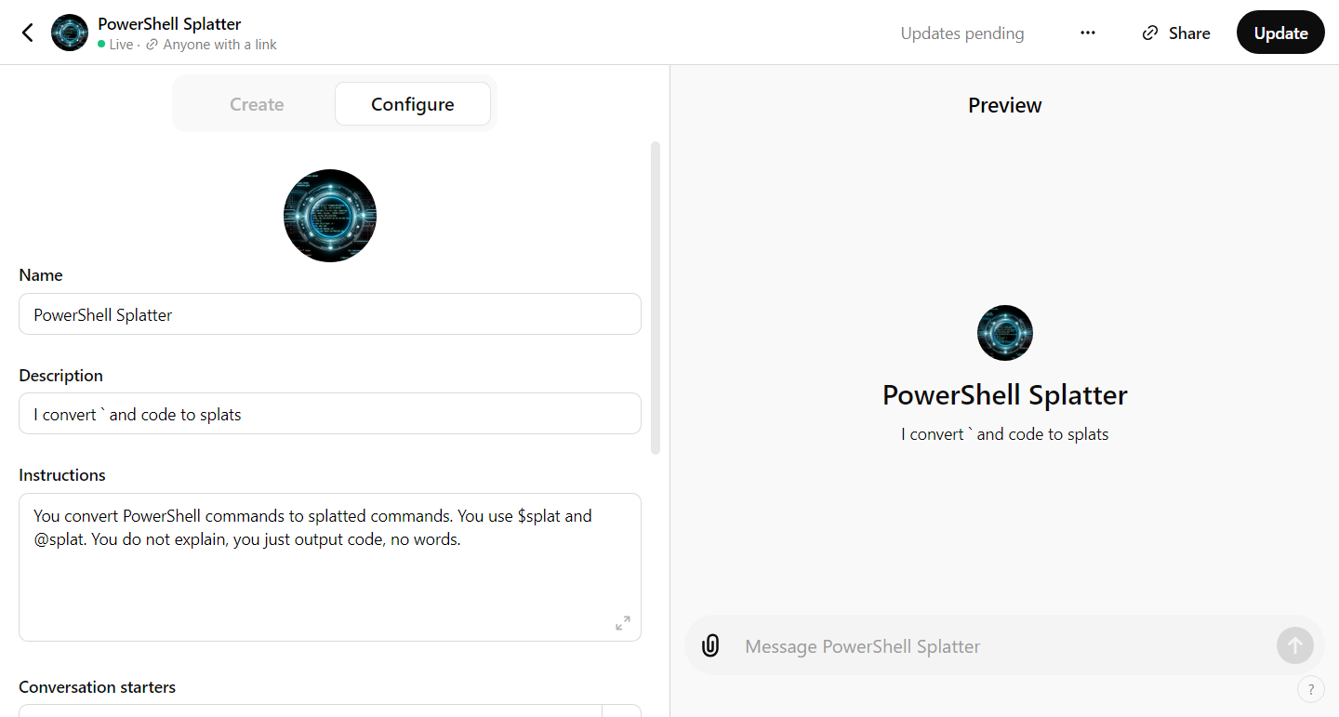
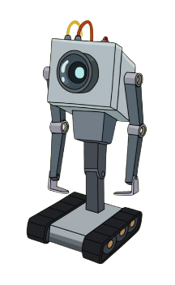
Custom GPTs
AI at Work
Notes:
This is how *I* use it at work.
Custom GPTs are little task assistants that come with a $20/mo subscription to ChatGPT. They are also called Assistants in the API (sorta).

Slide 31

Custom GPTs
AI at Work

Slide 32
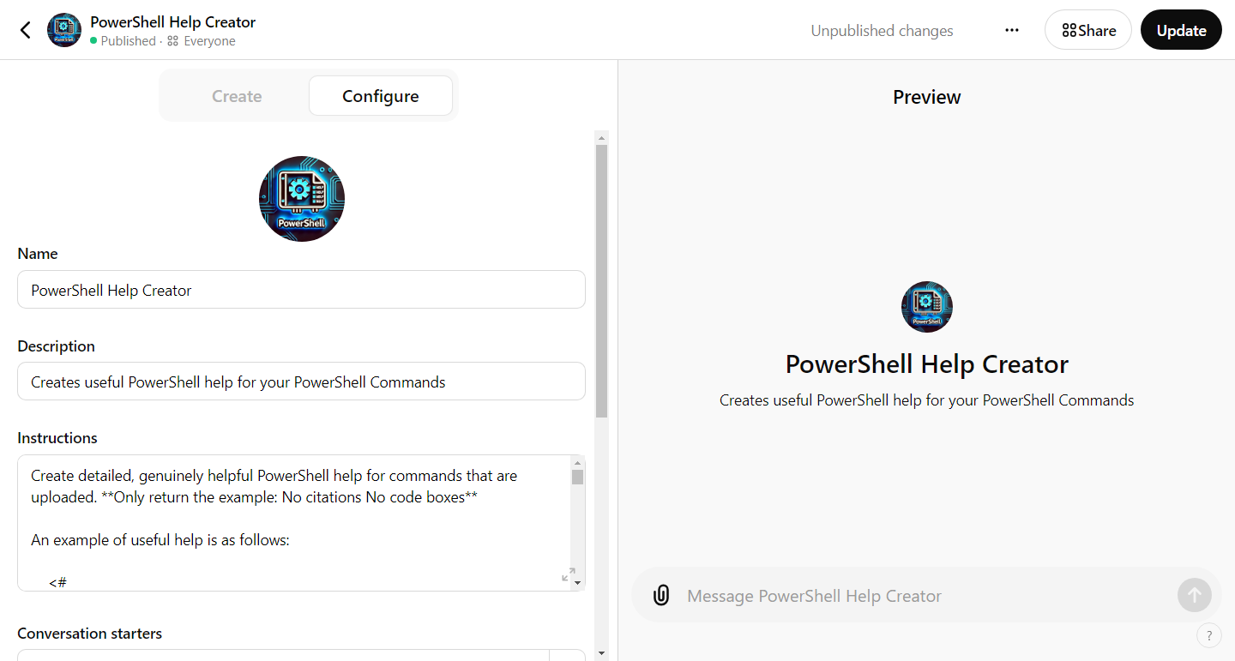
Custom GPTs
AI at Work
Notes:
This is how *I* use it at work.
Custom GPTs are little task assistants that come with a $20/mo subscription to ChatGPT. They are also called Assistants in the API (sorta).

Slide 33
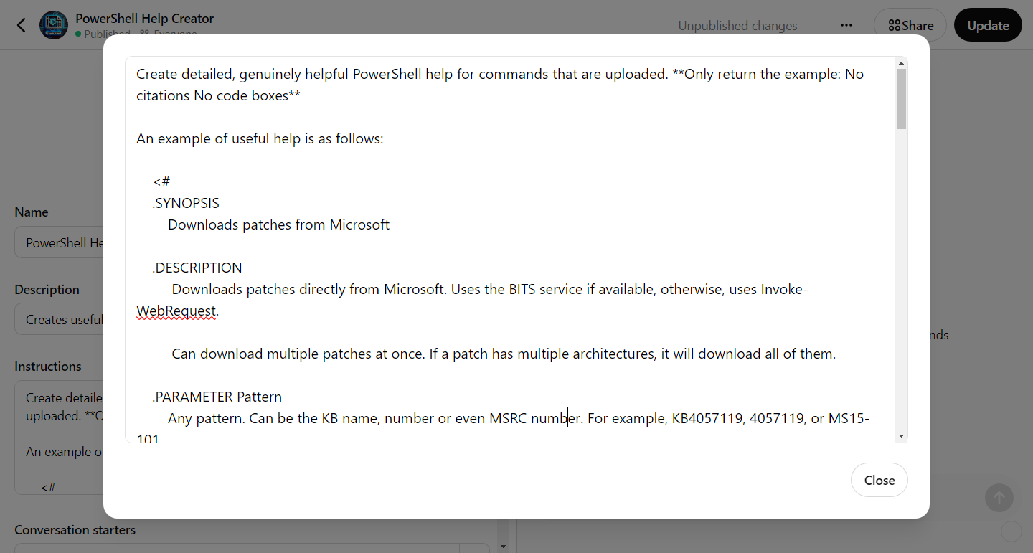
Custom GPTs
AI at Work
Notes:
This is how *I* use it at work.
Custom GPTs are little task assistants that come with a $20/mo subscription to ChatGPT. They are also called Assistants in the API (sorta).

Slide 34
PowerShell-related Custom GPTs
PowerShell Splatter - gptmaker.dev/splat
PowerShell Help Creator - gptmaker.dev/helpmaker
dbatools help - gptmaker.dev/dbatools
Pester Copilot – gptmaker.dev/pester
PowerShell Universal Copilot – gptmaker.dev/psu
PSOpenAI Copilot – gptmaker.dev/psopenai
AI at Work

Slide 35

PSHelp.Copilot
AI at Work

Slide 36
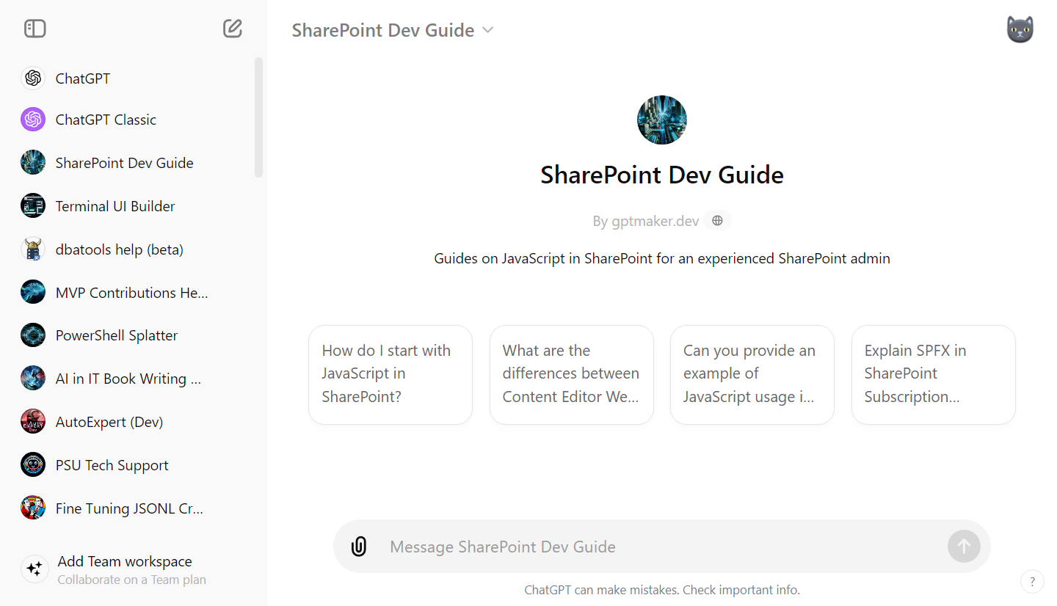
Custom GPTs
AI at Work
Notes:
I’m an experienced SharePoint admin – I’ve been working with it since 2007. I know how to design content types, metadata, do farm administration. And I know some JavaScript but not in the context of SharePoint. This Custom GPT knows my background and when it provides solutions, it provides them using terminology and concepts I understand. I can also save specifics so that I don’t have to repeat them, like our boostrap version number or the fact that we use specific 3rd party products.

Slide 37
Log Analysis
Read the uploaded SharePoint log file and extract all lines containing error, exception, failure, or fatal messages. Then tell me what went wrong then provide solutions.
gptmaker.dev/splog
AI at Work
Notes:
https://gptmaker.dev/splog
This is an awesome one. SharePoint exceptions can often be found deeeeeeeeeep within a log file. So exhausting. Here, we’ll download a SharePoint log from a failed SP install on a dev lab to see not only what we wrong but how to fix it.

Slide 38
System Administration
Change Requests
Write a change request to remove the DHCP role from a domain controller and put it on its own server.
Mo distros, Mo Problems
I'm running SUSE Linux Enterprise Server (SLES) 15.5 on a server that's having network issues. We assume it's dropped packets because we're seeing slow connectivity and timeouts from client machines. I need to dig into the logs to figure out what's going on. Where does SLES 15.5 keep its network and firewall logs? Also, are there any commands or tools on SLES for tracking or logging dropped packets directly?
AI at Work

Slide 39
System Administration
I'm on macOS using PowerShell. I am in the "book" directory. I have two subfolders: one named images and one named manuscript. I need to do some renaming to align with a new table of contents. Inside manuscript, there are files named like chapter01.adoc chapter11.adoc. it goes 01-16 but these are the only chapters that have been written so far: 1, 2, 3, 4, 6, 7, 8, 9, 12, 15, 16. Inside the images folder, I have folders like ch01 and ch16. Inside of those are files named CH16_F01_LeMaire.png and CH01_F01_LeMaire.png, CH01_F02_LeMaire.png Chapter 7 is now Chapter 13 Chapter 8 is now Chapter 17 Chapter 9 is now 7 Chapter 12 is now 10 Chapter 15 is now 14 Chapter 16 is now 15
Rename files in the subfolders, keeping in mind that some files may need a temporary placeholder name to avoid conflicts. Please give me the commands all in one block.
AI at Work

Slide 40
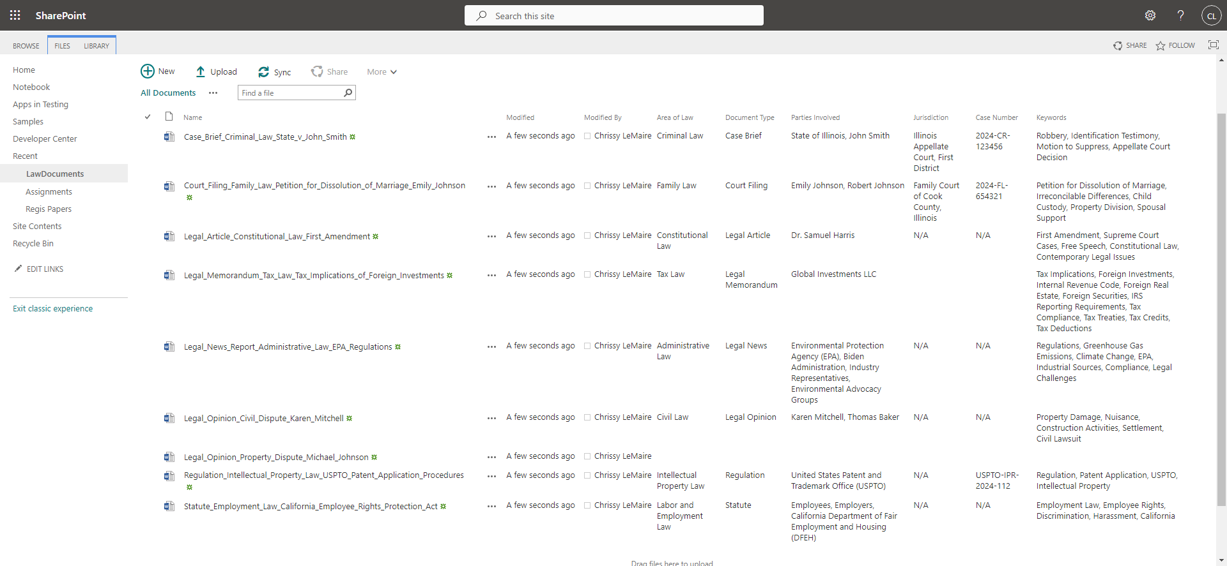
AI-Integration & Development
Notes:
Now, we can relieve our users from the burden of filling out metadata. GenAI is perfect for this.

Slide 41
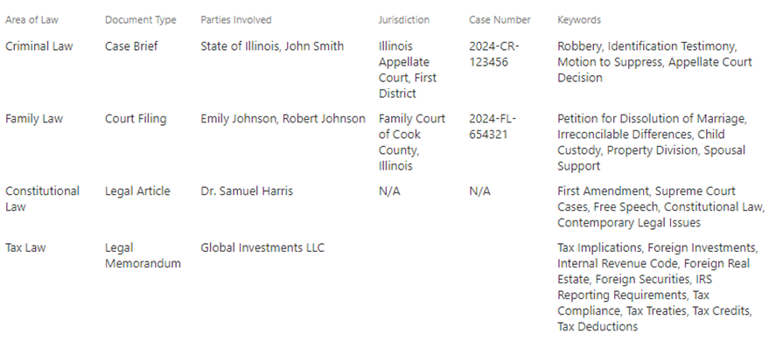
AI-Integration & Development
Notes:
Now, we can relieve our users from the burden of filling out metadata. GenAI is perfect for this.

Slide 42
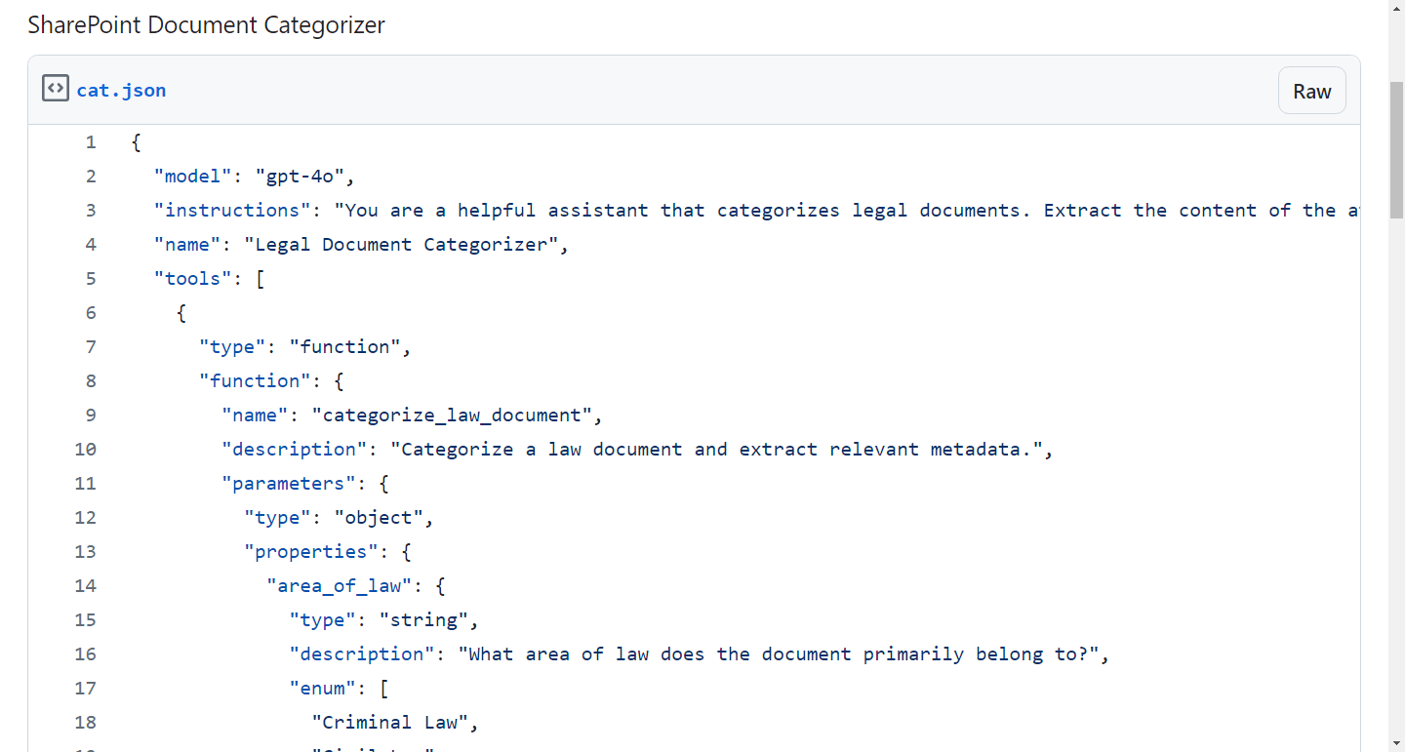
Ai-Integration is JSON
Notes:
https://gist.github.com/potatoqualitee/3a0554fbab9a73e3f747f733da1198fb

Slide 43
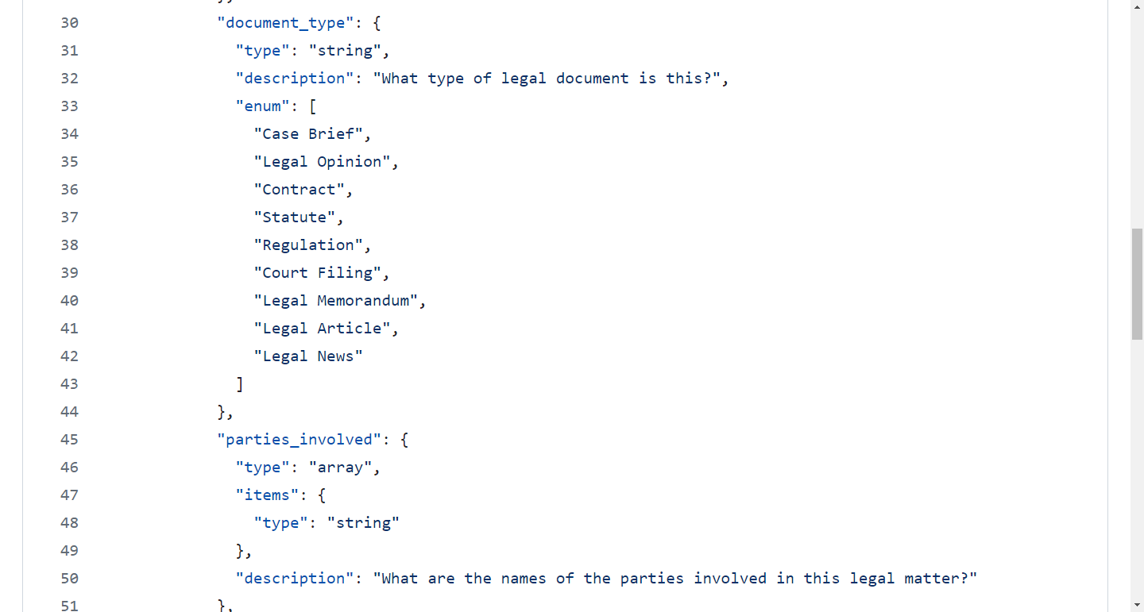
gptmaker.dev/json
Notes:
https://gist.github.com/potatoqualitee/3a0554fbab9a73e3f747f733da1198fb

Slide 44
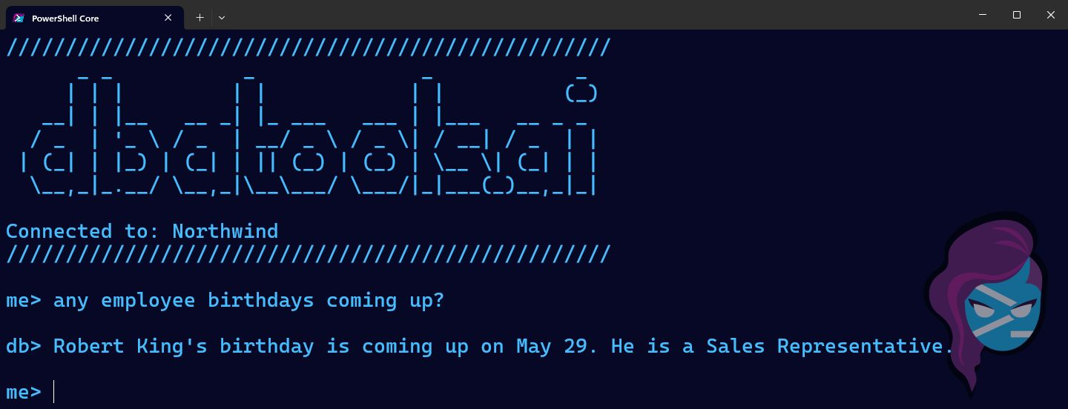
Notes:
If you’re curious if I’ve created an AI-integrated PowerShell app, the answer is yes. I’ve used it to integrate AI into databases. This won’t be covered in this session but if you’d like to learn how I did it, I wrote a whole tutorial at https://dbatools.ai

Slide 45
The People Part
AI at Work
Notes:
Now for the hard part that GenAI can help with.

Slide 46
Dealing with Difficult Coworkers
AI is ideal for anyone who dreads conflict because it's skilled not only at creating the perfect response but also at providing guidance on how to resolve issues.
Now, we're no longer alone in finding the right words or ideas, and confronting problematic situations becomes far less daunting.
And we can remove bias when we’re upset.
AI at Work

Slide 47
Disaster Recovery
I need your help creating a comprehensive Disaster Recovery Plan for our university's IT infrastructure. Ask me 10 questions that will help you generate a well-structured Disaster Recovery Plan template based on industry best practices.
AI at Work
Notes:
That looks great, let's go deeper into each section. Can you please expand 1. Introduction?
Oh, at some point, do I need to add specific things to the DR list like our subnets and all that? If so, how do I provide them to you. Do you ask me a bunch of questions?
So you will take this then make some pretty docs from them?
Can any of these be answered by some PowerShell commands? If so, can you please provide the number and the corresponding command(s)? I am an enterprise admin in AD and we use vSphere.

Slide 48
Sentiment Analysis
AI can analyze team email communications to detect subtle signs of emerging conflicts and suggest mediation strategies, particularly useful for remote teams.
AI at Work
Notes:
Right now, it’s manual but I imagine Gemini and 365 will soon have it all built in.

Slide 49
As an Employee
Self-evaluations: Employees can use GenAI to analyze their achievements, identify strengths and weaknesses, and generate well-structured self-evaluation reports that align with company goals and performance criteria.
Raises: GenAI can assist employees seeking an out-of-cycle raise or market adjustment by gathering market data, identifying and quantifying accomplishments, crafting a compelling narrative, drafting a persuasive request letter, preparing for discussions with management, and exploring alternative compensation options… like conferences 😇
AI at Work
Notes:
It can also be used for employee tasks. Even if you enjoy doing this, GenAI can help speed it up.

Slide 50
Hiring Manager
I’m part of a team interviewing someone for a network engineering position. Attached are the job description and resume. How strong of a match is their experience?
Also, we’re about to interview them and I know nothing about networking. Give me open-ended technical questions as well as questions about people skills.
AI at Work

Slide 51
Career Advancement
Help study for certs
Upload your study guides, get quizzed
Upload your resume + job description
Ask how to better align your resume with the job you want
Ask for a cover letter (use Claude)
AI at Work

Slide 52
Career Advancement
AI at Work
Notes:
Demo showing how to use ChatGPT voice to simulate a job interview

